Slide 1
Welcome address
Andy Götz – PaNOSC Coordinator
ESRF
29 November 2022
This project has received funding from the European Union’s Horizon 2020 research and innovation programme under grant agreement No. 823852

Slide 2


PaN EOSC

Slide 3

Welcome !
To the PaNOSC Closing Event in Grenoble
We are very pleased to welcome all partners + stakeholders:
PaNOSC project members
ExPaNDS project members
Science Cluster coordinators
EOSC-Association directors
National projects – HMC, DAPHNE, NFFA, E-RIHS, …
Learned societies – IUCr CommDat
e-infrastructures, collaborators, friends, …

Slide 4

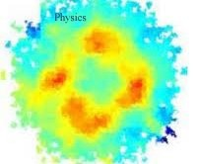

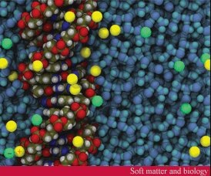
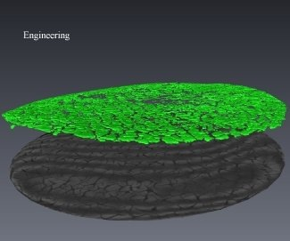

Photons and Neutrons cover Broad time and length scales
PHYSICS
ANGSTROMS AND PICOSECONDS
electronic and magnetic structure
strongly correlated electron systems
CHEMISTRY
NANOMETRES AND NANOSECONDS
chemical structure and dynamics
structure/property relationships
SOFT MATTER & BIOLOGY
MICRONS AND MICROSECONDS
interfaces, micelles, etc.
protein structure and dynamics
eNGINEEring & MATERIALs SCIENCE
METRES AND MONTHS
engineering measurements, heritage science
Imaging, tomography, strain & stress, etc.
4
A. Gotz – PaNOSC project – EOSC Stakeholders meeting 22 November 2018.
This project will receive funding from the European Union's Horizon 2020 research and innovation programme under grant agreement No 823852

Slide 5
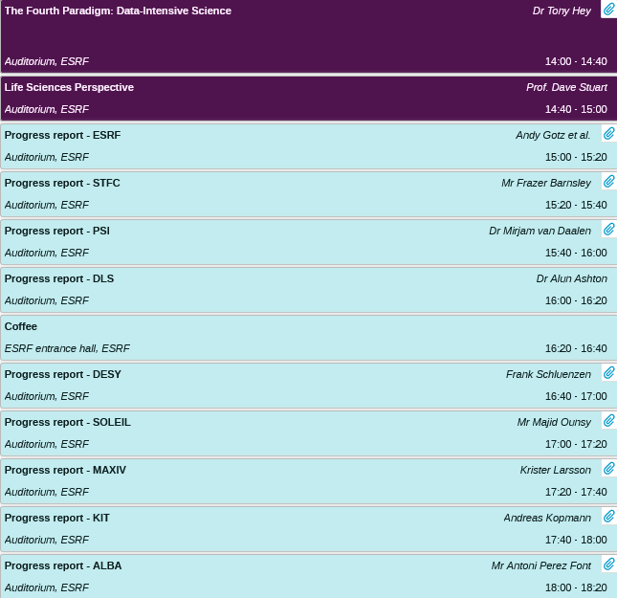
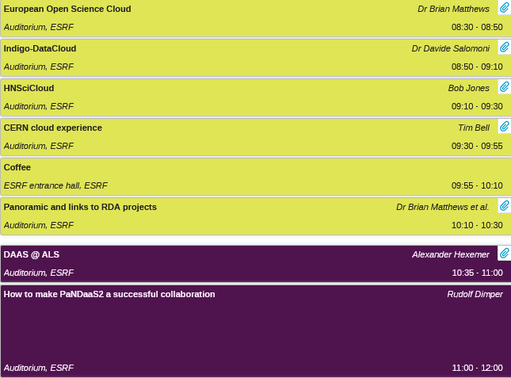
Data Analysis as a Service – PaNDAAS meeting at ESRF (July 2016)

Slide 6

PaNOSC @ EOSC Stakeholders meeting in Brussels (November 2018)
Photon and Neutron Open Science Cloud
A. Götz
on behalf of the PaNOSC consortium
22 November 2018
A. Gotz – PaNOSC project – EOSC Stakeholders meeting 22 November 2018.
This project will receive funding from the European Union's Horizon 2020 research and innovation programme under grant agreement No 823852

Slide 7


PaNOSC Goals
Data Stewardship
Generalise the adoption of FAIR open data principles
EOSC
Federate data catalogs and integrate in EOSC and OpenAire meta-catalog, AAI, download services
Data Services
Develop new data analysis, modelling and simulation services
User Training
Train users how to write Data management plans, improve metadata, using DOIs, manage data better
A. Gotz – PaNOSC project – EOSC Stakeholders meeting 22 November 2018.
This project will receive funding from the European Union's Horizon 2020 research and innovation programme under grant agreement No 823852

Slide 8

Conclusion @ EOSC Stakeholders meeting
PaNOSC is a joint effort to help the ESFRI Photon and Neutron sources to
adopt and implement data management, simulation and analysis services
for dealing with the increasing data rates and volumes and making
Open Data available to the EOSC
Open Data & Open Science
builds on
Data Management, Simulation
& Analysis Services
A. Gotz – PaNOSC project – EOSC Stakeholders meeting 22 November 2018.
This project will receive funding from the European Union's Horizon 2020 research and innovation programme under grant agreement No 823852

Slide 9
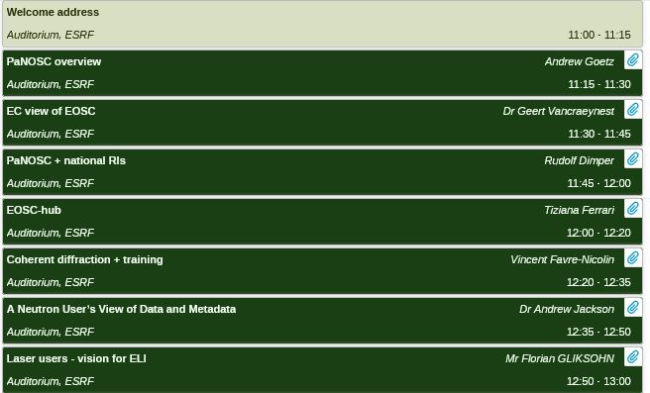
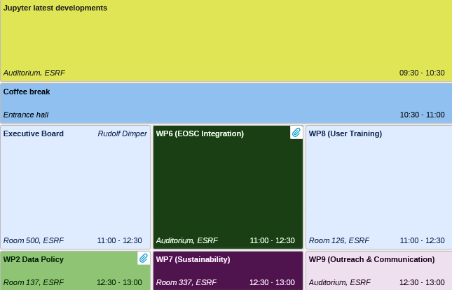
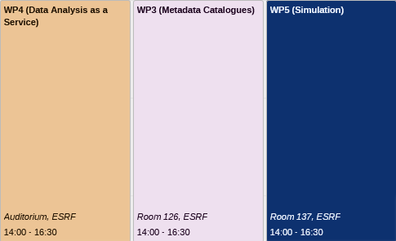
PaNOSC Kickoff meeting at ESRF (January 2019)

Slide 10
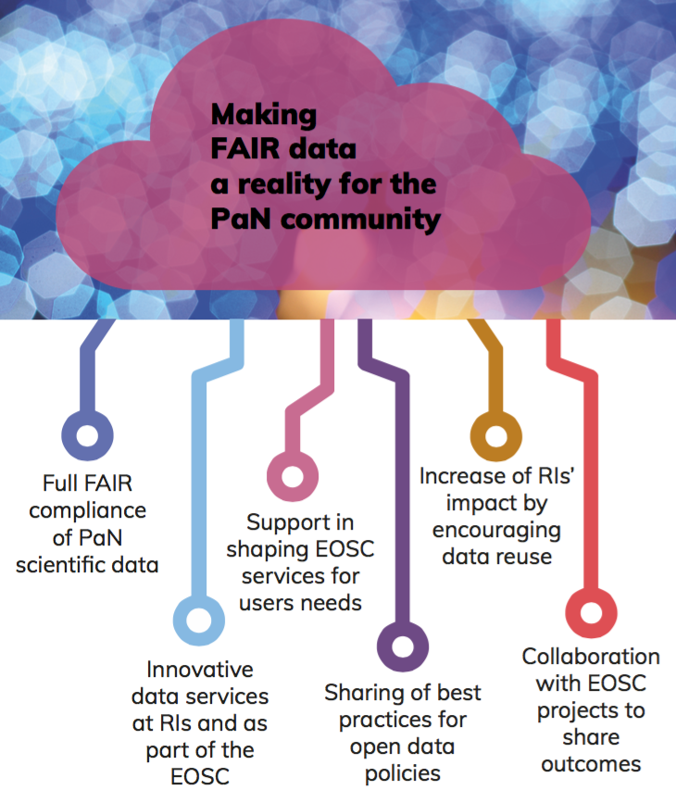
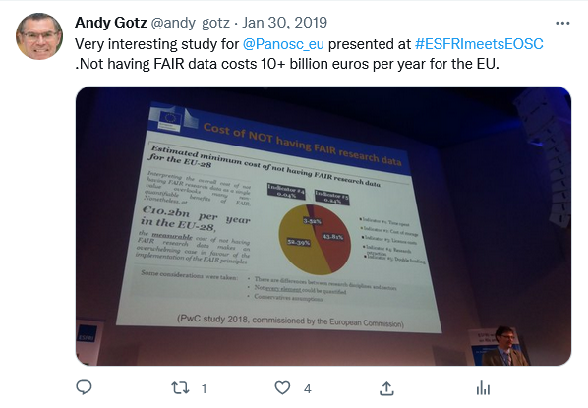
PaNOSC goals
PaNOSC works closely with the PaN sources in Europe to develop common policies, strategies and solutions in the area of FAIR data policy, data management and data services, integrating them into the EOSC.
This project has received funding from the European Union’s Horizon 2020 research and innovation programme under grant agreement No. 823852

Slide 11

Photon and Neutron Open Science Cloud
The PaNOSC Project
R. Dimper – on behalf of the Consortium
30 January 2019
R Dimper – PaNOSC @ ESFRI RIs-EOSC liaison workshop – 30 January 2019

Slide 12
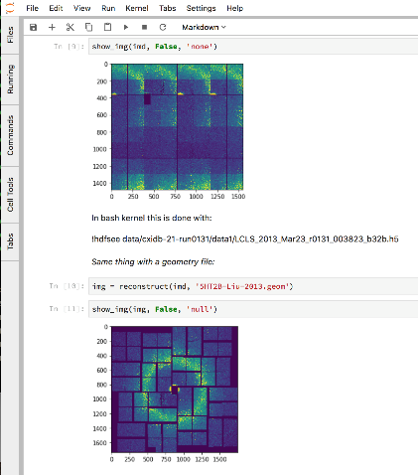
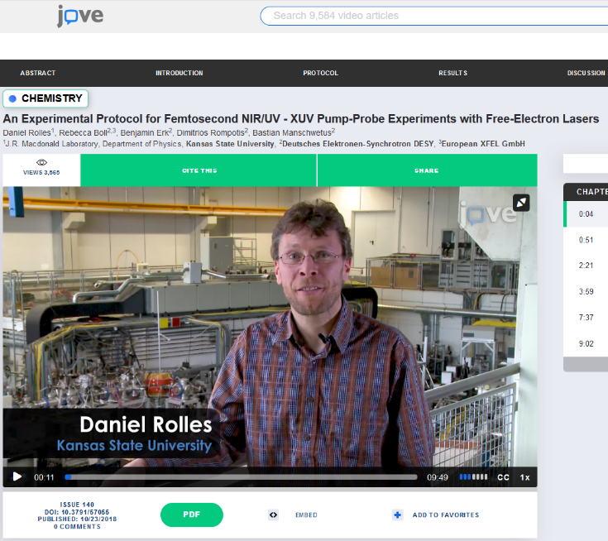
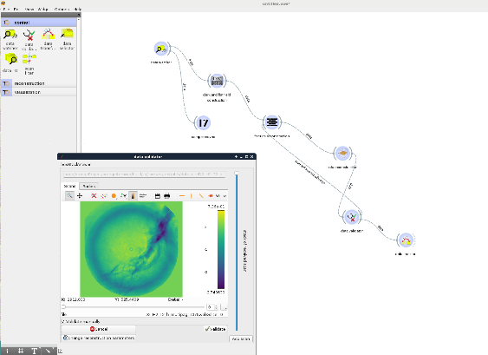
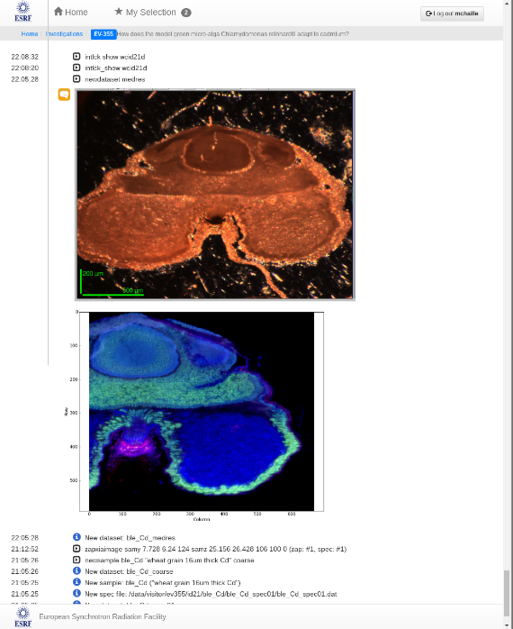
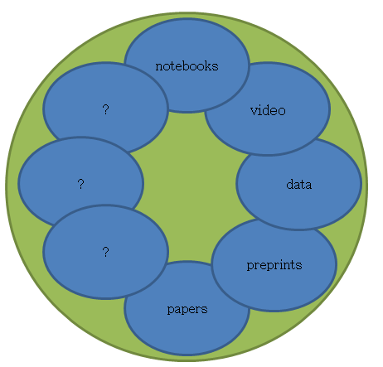
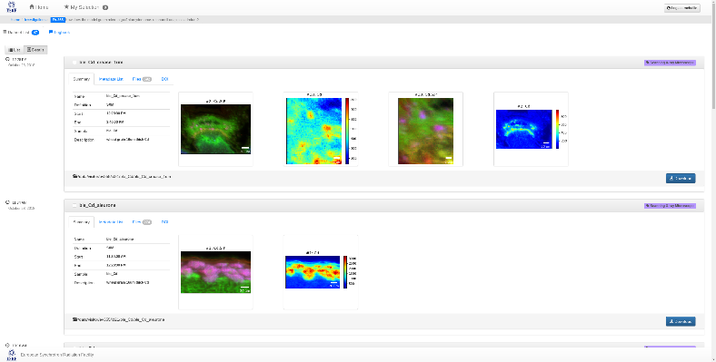
PaNOSC aim - link all scientific data + output together
Image Source: http://michaelnielsen.org/blog/the-future-of-science-2/
Workflow
Logbook
Software
This project has received funding from the European Union's Horizon 2020 research and innovation programme under grant agreement No 823852
PaNOSC Overview @ Kickoff Meeting - 15/01/2019 - Andy Götz

Slide 13
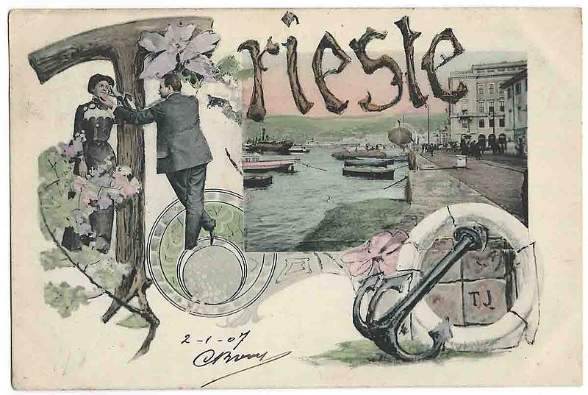
PaNOSC First Annual Meeting organized by CERIC-ERIC in Trieste in November 2019
WELCOME TO THE 1st PANOSC ANNUAL MEETING !

Slide 14
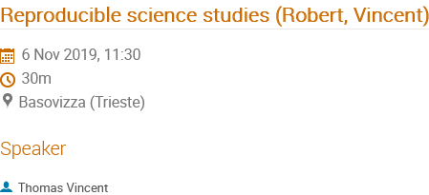
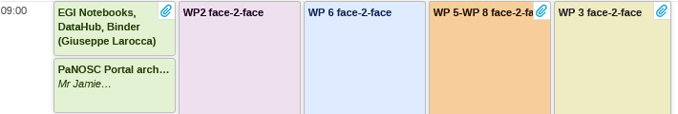
PaNOSC First Annual Meeting in Trieste at CERIC-ERIC (November 2019)

Slide 15
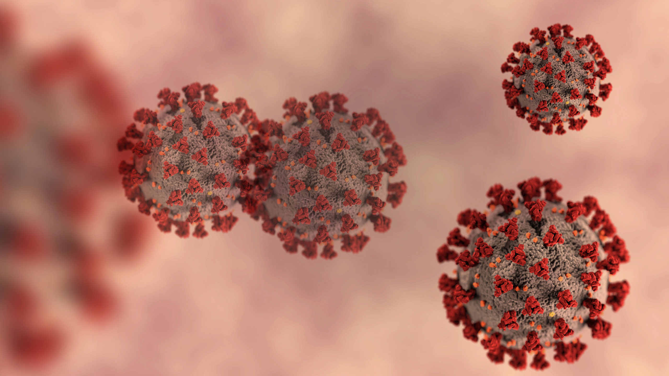
And then came COVID-19 … and BOOM we moved to ZOOM for 2 years 2020+2021

Slide 16


KPIs - Before PaNOSC - 2018
 | ILL | ESRF | CERIC | XFEL | ELI | ESS
Data / yr | 200 TB | 8 PB | 1 PB | 3PB | < 1 PB | 0
Data Policy | 2011 | 2016 | 2014 (3/8) | 2017 | In progress | 2017
Metadata catalogue | Local | Icat | Local | myMdC | No | SciCat
Metadata definitions | Nexus | Nexus | custom | myMdC | ? | Nexus
DOI | 2012 | 2018 | No | 2018 | No | 2018
Open Data | Yes | Yes | No | Yes | No | No
Data Services | Pilot | In progress | Remote | In progress | ? | In progress
Common data API | No | No | No | No | No | No
User training | No | No | No | No | No | No

Slide 17
KPIs - After PaNOSC - 2023
 | ILL | ESRF | CERIC | XFEL | ELI | ESS
Data / yr | 600 TB | 50 PB | 15 PB | 100PB | 10 PB | <1PB
Data Policy | 2011 | 2016 | 2019 | 2017 | 2019 | 2017
Metadata catalogue | Local | Icat | Icat | myMdC | [TBD] | SciCat
Metadata | Nexus | Nexus | Nexus | Nexus | [Nexus] | Nexus
Metadata collection | All BLs | All BLs | All BLs | All BLs | All BLs | All BLs
DOI | Yes | Yes | Yes | Yes | Yes | Yes
Open Data | Yes | Yes | Yes | Yes | Yes | Yes
Common API | Yes | Yes | Yes | Yes | Yes | Yes
User training | Yes | Yes | Yes | Yes | Yes | Yes
Data Services | Prod | Prod | Prod | Prod | Prod | Prod
EOSC | Integrated | Integrated | Integrated | Integrated | Integrated | Integrated

Slide 18
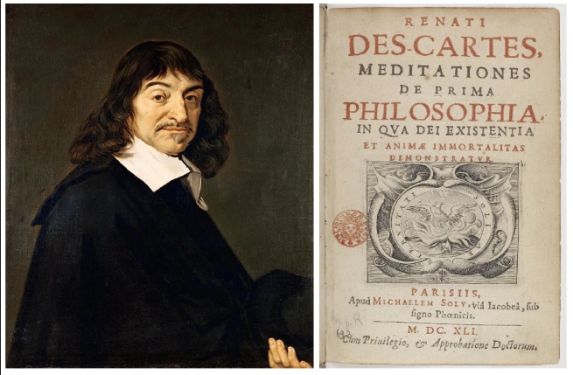
The world’s first Open Scientist?
The first was never to accept anything as true if I did not have evident knowledge of its truth
The second, to divide each of the difficulties I examined into as many parts as possible and as may be required in order to resolve them better.
The third, to direct my thoughts in an orderly manner, by beginning with the simplest and most easily known objects in order to ascend little by little, step by step, to knowledge of the most complex,
And the last, throughout to make enumerations so complete, and reviews so comprehensive, that I could be sure of leaving nothing out

Slide 19
Open Access – problems with Elsevier already in 1636?
to Mersenne, iii.1636:
About five weeks ago I received your most recent letter, dated 18.1.36; I hadn’t received its predecessor until four or five days before that. I postponed replying to you because I reckoned on being able to tell you soon that I had sent ·my work· to the printer. [This refers to Discourse on the Method, with the Optics, Meteorology, and Geometry, published by Jean le Maire of Leiden in June 1637.] That’s why I came here to Leiden, because the Elseviers have said they would like to be my publishers. But now that they’ve seen me here they seem to think that they have caught me, which has led them to make difficulties; so I have decided to drop them.

Slide 20


350+ years later

Slide 21

Enjoy the Closing Event session talks + take part in the discussions + chats!

Slide 22

Thank you
andy.gotz@esrf.fr

Slide 23
Project conclusion
Four years of PaNOSC
Team effort has been essential
WP leaders have been the driving force
WP members have been the working force
Project has achieved almost all of its KPIs
Description of Work for the project steered the project
COVID-19 was a challenge but also an opportunity e.g. for VISA, remote experiments, data portal, remote collaboration etc.
Collaboration with ExPaNDS was essential, without it the PaN community would not be in a position to continue as a community

